Slide 1
A Sandwich DNA Model for Rapid and Sensitive Detection of NSCLC Utilizing the Magnetic Modulation Biosensing System
Saar Ashri
The Open University
Optical Imaging and Biosensing Laboratory
Bar-Ilan University
Under the Supervision of Dr. Amos Danielli
כסלו תשע"ז
December 2016

Slide 2
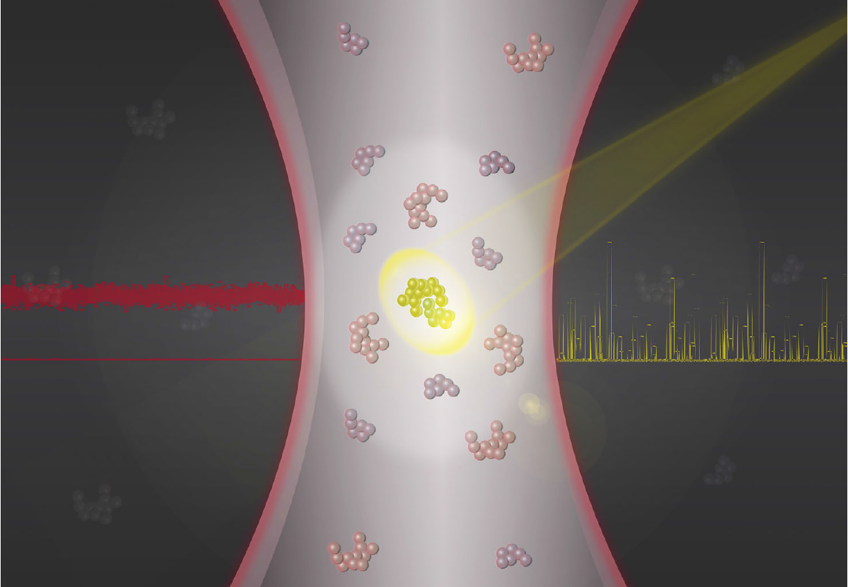
How do we detect a target analyte at ultra-low concentrations?
Notes:
In 2015, the US government announced the Precision Medicine Initiative, which is aimed at improving disease treatment and diagnostic. The challenge is how to detect a target analyte at ultra low concentrations?

Slide 3
Limitations of fluorescent biosensing
Fluorescent marker
Solution
(blood)
Target
(analyte)
Laser beam
Unbound fluorescent marker
^{[1]} A. Danielli et al., Optics Express, 16, 19253-19259 (2008)
Notes:
1. What I will try to do now is briefly explain the underlying magic of our technology.
First, let me describe the challenges in detecting small concentrations of any target molecule.
Imagine you have a solution with target molecules in it, for example, troponin I.
Now, clinical chemists know how to specifically label the target molecules with fluorescent markers.
To see these markers, you need to shine laser light onto the solution.
However, at low concentration, you only have 2-3 molecules inside your laser beam, and therefore the fluorescent light is very weak and further masked by the background noise from other molecules.

Slide 4
Magnetic Modulation Biosensing (MMB)
Magnetic bead
Magnetic poles
Unbound fluorescent marker
^{[1]} A. Danielli et al., Optics Express, 16, 19253-19259 (2008)
Notes:
To overcome this problem, we attach magnetic beads to the target molecules.
and we place two external magnetic poles outside the solution holder.

Slide 5
Magnetic Modulation Biosensing (MMB)
Magnetic bead
Magnetic poles
Unbound fluorescent marker
^{[1]} A. Danielli et al., Optics Express, 16, 19253-19259 (2008)
Notes:
3. Once we activate the magnetic poles, the fluorescent molecules from the entire solution aggregate into your detection volume.
Instead of 2-3 molecules you have thousands of molecules and the signal is orders of magnitudes bigger.

Slide 6
Magnetic Modulation Biosensing (MMB)
Magnetic poles
Background noise
^{[1]} A. Danielli et al., Optics Express, 16, 19253-19259 (2008)
Notes:
5. To eliminate the noise from the background molecules, we move the magnetic beads from side to side, in and out of the laser beam spot.
Every time they pass through the laser beam, they generate light.
All we have to do now is to detect a flashing signal, which is significantly distinguished from the constant background noise.
The modulation from side to side eliminates the need to wash the solution from background molecules.
Therefore, our test can be done in a single step; you just mix everything together and wait for the results.
The increased sensitivity and simplicity is what differentiate us from other technologies.

Slide 7
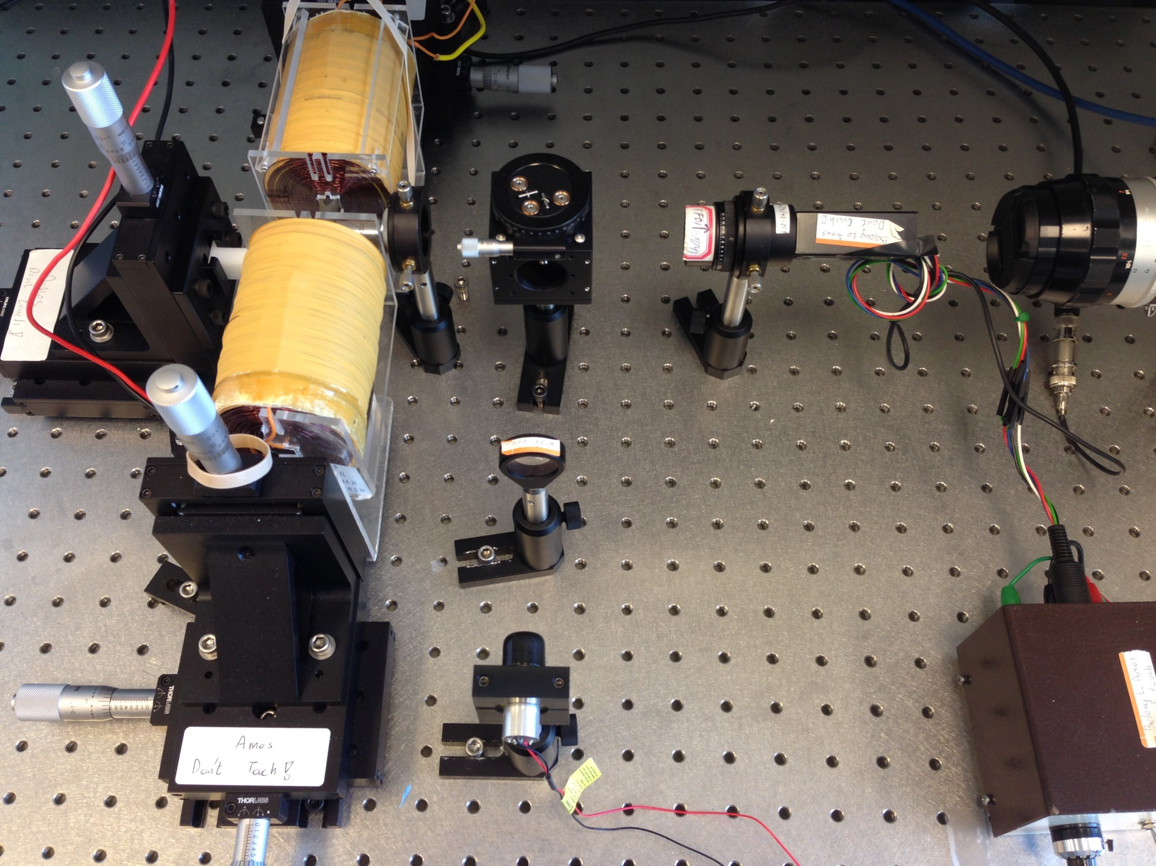
The optical setup
Objective lens
Dichroic mirror
Camera
Sample
Photo detector
Electromagnets
Diode laser
Notes:
The set-up is very simple. We have a small diode laser as our light source, a dichroic mirror reflects the laser light to an objective lens, which focuses the light on the sample. The fluorescence light is collected by the same objective lens, transfer through the dichroic mirror, emission filters, and a pinhole to a photo-detector. We also have a camera for alignment.
The data from the PMT is collected and demodulated using a lock-in amplifier.

Slide 8
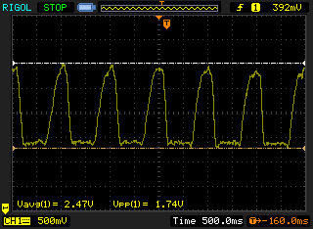
Data collection
With target
Without target
Notes:
Here you can see a close up of the aggregated beads. For visualization purposes, we used white light and an increased number of beads. Here you can see the laser light, now we turn off the white light and close the pinhole. On the other hand you can see the same sample without the target molecules. Here is the signal generated from the PMT. The amplitude of the peak represents the amount of fluorescence light (and therefore target molecules) on the beads.

Slide 9
The Research Question
Is there a correlation between the ctDNA in the liquid biopsy to the excitation level?
Are we able to quantify the ctDNA levels using calibration curve?

Slide 10
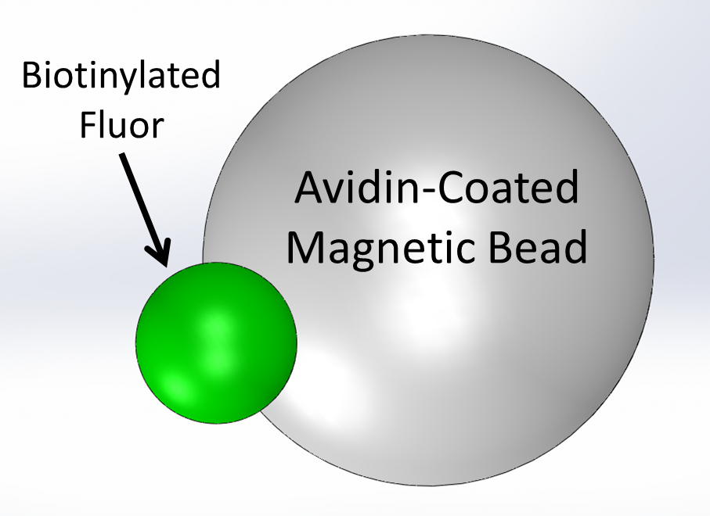
System characterization – Atto 532
Streptavidin

Slide 11
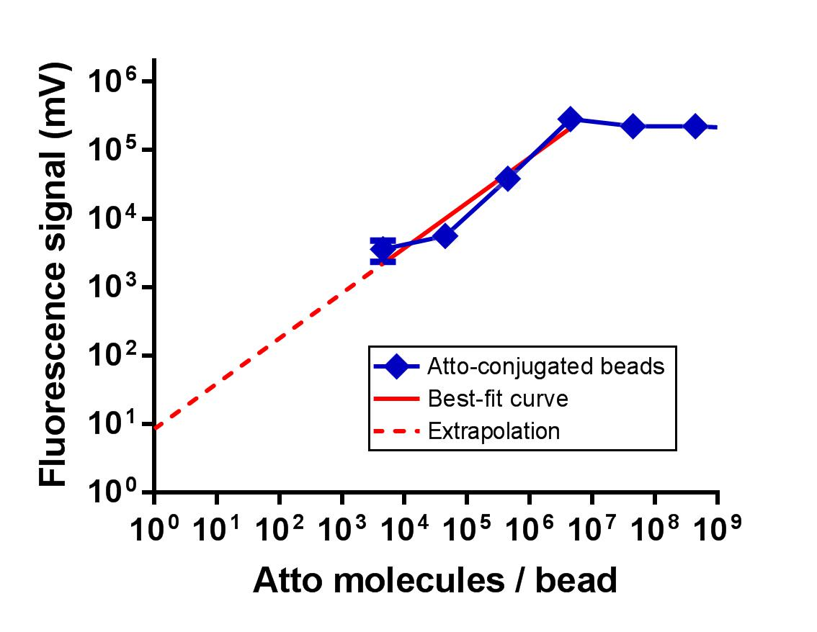
3-log dynamic range
Error bars = SD
n=3
3-log dynamic range

Slide 12
Full assay – sandwich DNA
Streptavidin
^{[1]} A. Danielli et al., Curr. Pharm. Biotechnol. , 11 (2010)

Slide 13
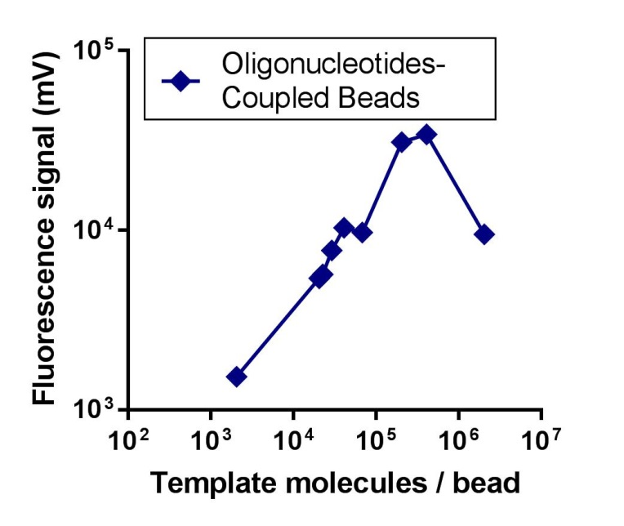
Full assay – sandwich DNA
Template-

Slide 14
Summary of Results
There is a correlation between the number of Atto molecules per bead to the fluorescence level
There is a correlation between the ctDNA complexes (or ‘Templates’) to the fluorescence levels
At a certain point (x≈10⁶ template molecules/bead) we saw a ‘hook sign’ which signals the upper limit of quantification and the binding capacity of the bead itself

Slide 15
Conclusions
MMB’s unique properties are aggregation and modulation.
MMB’s advantages are: fast reaction time, sensitivity, and simplicity (no washing steps)
MMB is particularly suitable for point-of-care applications and resource-limited settings
Notes:
In conclusion, we showed that the MMB can be used for rapid and sensitive detection of protein at low concentrations.
The MMB unique properties are the aggregation and modulation, which enable fast reaction time, high sensitivity, and simplicity (no washing steps).
In particular, theses qualities suggest that the MMB system can be used for point-of-care applications and resource limited settings.
Potential applications include: viruses, cardiac biomarkers, Traumatic Brain Injury biomarkers, etc. IN fact, any assay that as a result of the bio-recognition event produces light, can be used in the MMB system.

Slide 16
Future Perspectives
The field of liquid biopsy encloses methods that may simplify and ease the lives of many patients
Further researches are required for the field to develop
ctDNA is a great, potent target for analysis
A well-developed protocol for bleaching the beads is desirable

Slide 17
A Sandwich DNA Model for Rapid and Sensitive Detection of NSCLC Utilizing the Magnetic Modulation Biosensing System
Saar Ashri
The Open University
Optical Imaging and Biosensing Laboratory
Bar-Ilan University
Under the Supervision of Dr. Amos Danielli
כסלו תשע"ז
December 2016

